Slide 1
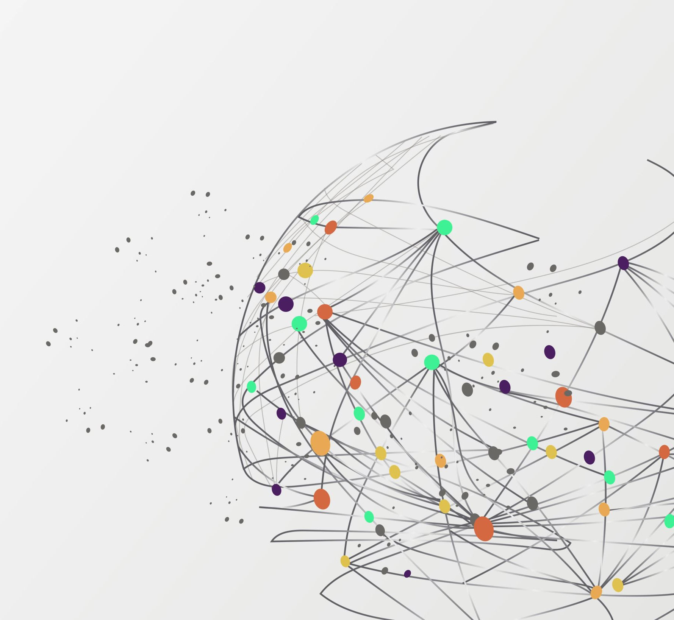
LULC Level-2 Classification Using AI/ML
MINOR PROJECT
Supervisor : Dr. Nancy Singla
GROUP NO - 57
Submitted By:
Prakhar Varshney (211327)

Slide 2
Contents
Introduction
Literature Survey
Problem Formulation and Objective
Project Design
Tools , Technologies and Datasets
Project plan
References

Slide 3
What is LULC &
Level-2 Classification
INTRODUCTION
LULC: Land Use and Land Cover (LULC) refers to a classification system used to categorize and describe the various types of land cover and land use across a geographical area.
Land Use refers to the human activities and purposes for which land is utilized. eg - Residential (urban, suburban)
Land Cover describes the physical and biological materials on the Earth's surface, including natural and artificial features. eg - Forest , Grassland , Wetland etc
Level 2 classification is an intermediate level of classification between higher levels of generalization(Level 1 classification) and more detailed levels of specificity (Level 3 classification).
In a Level 2 classification system, land cover types are grouped into relatively broad and distinct categories, which may include classes such as forests, urban areas, agricultural land, water bodies, barren land, etc.

Slide 4
Uses of Machine learning in LULC Level-2 Classification
CONT..
Automated Feature Extraction:
ML algorithms can automatically extract relevant features from satellite imagery, such as texture, color, and spatial patterns, without the need for manual feature engineering.
Multi-class Classification:
Machine learning algorithms excel in multi-class classification tasks by effectively distinguishing between different land cover types based on their unique spectral signatures.
Handling Large Datasets:
Machine learning techniques are well-suited for handling large volumes of satellite data, which is often the case in Level 2 classification tasks covering extensive geographical areas.

Slide 5
Literature Review
S.NO | Paper Title [Cite] | Journal/ Conference(Year) | Technique Used | Results | Limitations
1 | LULC classification by semantic segmentation of satellite images using FastFC [1] | 2nd International Conference on Advanced Information and Communication Technology (ICAICT)(2020) | FastFCN, eCognition, Geographic Information System (GIS) software | FastFCN achieved an average accuracy of 91.0% and average IoU of 0.84 | Segmentation errors: sharp edges, unbalanced class training, confusion between classes like "meadow" and "forest".
2 | LULC Image Classification With Convolutional Neural Network [2] | IEEE International Geoscience and Remote Sensing Symposium IGARSS(2021) | Data augmentation techniques (rotation, flip, zoom, shearing, shifting) enhanced training samples. | The model exceeded the state-of-the-art with a 12.3% accuracy boost & superior metrics. | Misclassifications occurred due to textural and spectral similarities, especially between Storage tanks and Buildings classes.
3 | Fusion of Sentinel-1 and Sentinel-2 images for classification of agricultural areas using a novel classification approach [3] | IGARSS 2018 - 2018 IEEE International Geoscience and Remote Sensing Symposium | Phenological Sequence Pattern method classified crops using dense seasonal image stacks. | PSP outperformed Random Forest for S1 and fused S2 images. | Cloud cover reduced S2 availability, affecting crop classification, especially for crops like spring barley.

Slide 6
S. NO | Paper Title [Cite] | Journal/ Conference(Year) | Technique Used | Results | Limitations
4 | A Multiclass Deep Learning Approach for LULC Classification of Multispectral Satellite Images [4] | IEEE India Geoscience and Remote Sensing Symposium (InGARSS) (2020) | The paper uses a modified SegNet for multispectral satellite image segmentation. | Four major LULC classes - water, forests, crops, and built-up areas - classified with an average F1 score of 0.84. | The study's focus on Mandya, Karnataka, India, may restrict its generalizability to other regions.
5 | A Tile-Based Approach for the LULC Classification of Sentinel Image Using Deep Learning Techniques [5] | Presented at the International Conference for Advancement in Technology (ICONAT) (2022) | Deep learning techniques, including ResNet50, VGG16, and DenseNet201, for Sentinel-2 land use classification. | ResNet50 achieved the highest classification accuracy of 98.47% on the test data. DenseNet201 achieved an accuracy of 90.23%. | Manual labeling by domain experts in dataset creation may introduce subjective biases and may not be scalable for large-scale mapping projects.
6 | From Supervised to Unsupervised Learning for Land Cover Analysis of Sentinel-2 Multispectral Images [6] | GARSS 2020 - 2020 IEEE International Geoscience and Remote Sensing Symposium . | CNN architecture, Unsupervised land cover classification, Band combination for feature extraction from Sentinel-2 | CNN architecture, Transfer learning from pre-trained hyperspectral model | Limited discussion on scalability and generalization across diverse regions or land cover types.

Slide 7
S.NO | Paper Title [Cite] | Journal/ Conference(Year) | Technique Used | Results | Limitations
7 | Best Accuracy Land Use/Land Cover (LULC) Classification to Derive Crop Types Using Multitemporal, Multisensor, and Multi-Polarization SAR Satellite Images [7] | Foody, G.M. Status of land cover classification accuracy assessment. Remote Sens. Environ. (2002) | Maximum Likelihood and Random Forest classifiers for LULC classifications | Highly accurate LULC maps with up to 8m resolution was achieved with improved crop classification accuracy | Cloud cover limited optical image use
8 | Deep Learning Methods for Land Cover and Land Use Classification in Remote Sensing [8] | A. Hamida, A. Benoit, P. Lambert, and C. Amar, “3-D Deep Learning Approach for Remote Sensing Image Classification,” IEEE Trans. Geosci. Remote Sens., vol. 56, no. 8, pp. 4420–4434, (2018) | Advanced DL methods such as CNN, GAN, RNN are utilized for land cover classification | DL methods show high accuracy for LCLU classification in RS imagery | Limited data availability, model complexity, and training time constraints in deep learning research.

Slide 8
Problem Statement and Objective:
Problem Statement:
Automatic categorization and classification of Land Use Land Cover (LULC) is important for sustainable development, autonomous agriculture, and urban planning. The challenge before us revolves around creating an Automated LULC classification system.
This specific task is formulated as a multi‐class classification problem, requiring the development of a model that can precisely categorize various LULC Level‐2 classes.
Objective:
Develop robust DNN (Deep Neural Network)/ML (Machine Learning) models to predict LULC Level‐2 classes using Satellite Datasets.

Slide 9
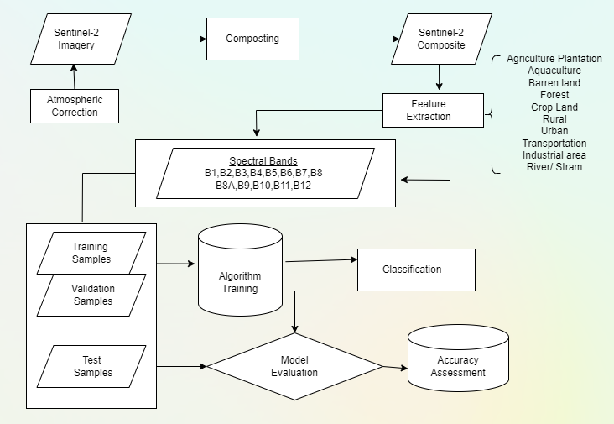
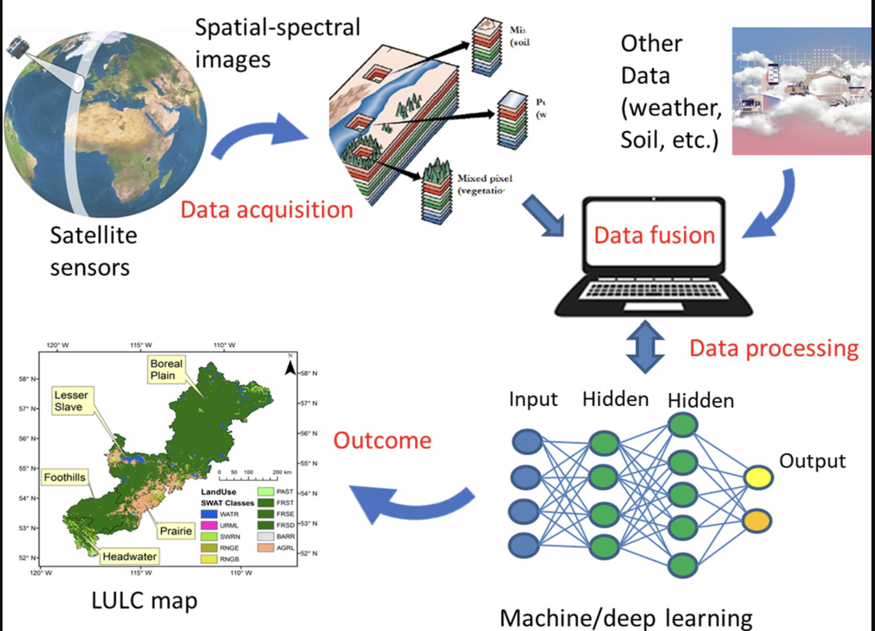
Project Design:
Fig. 1 [9]
Fig. 2

Slide 10
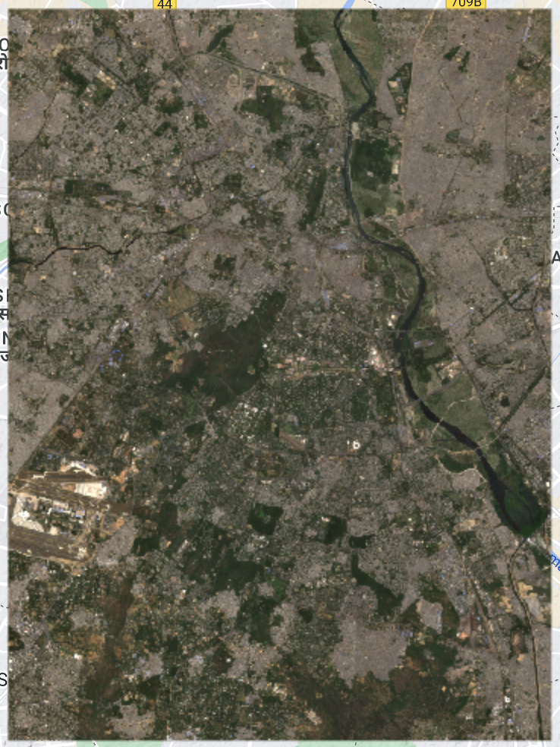
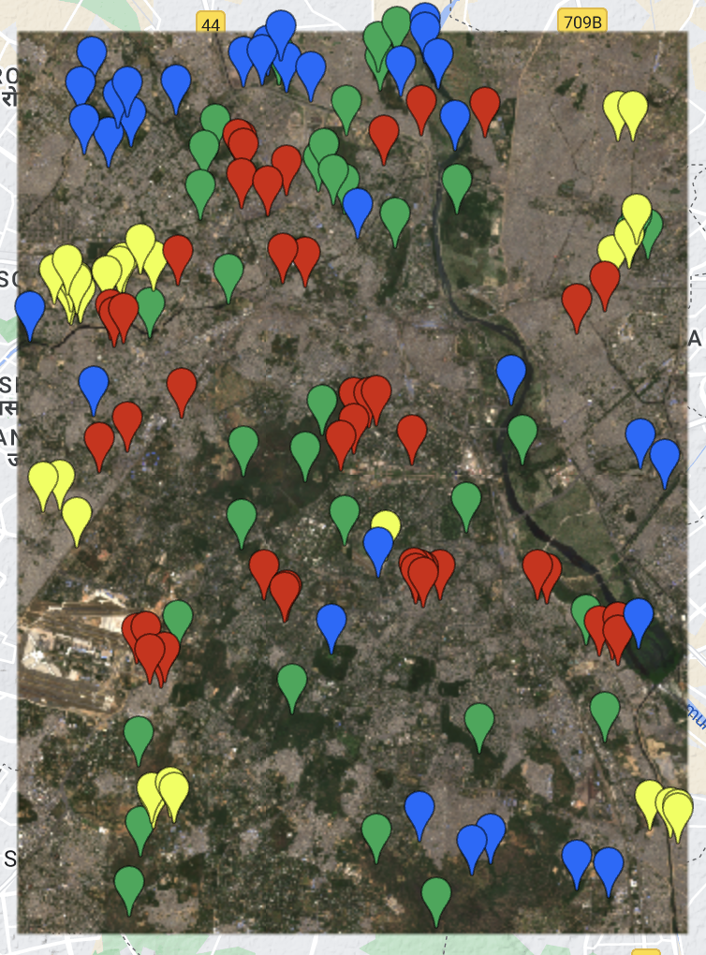
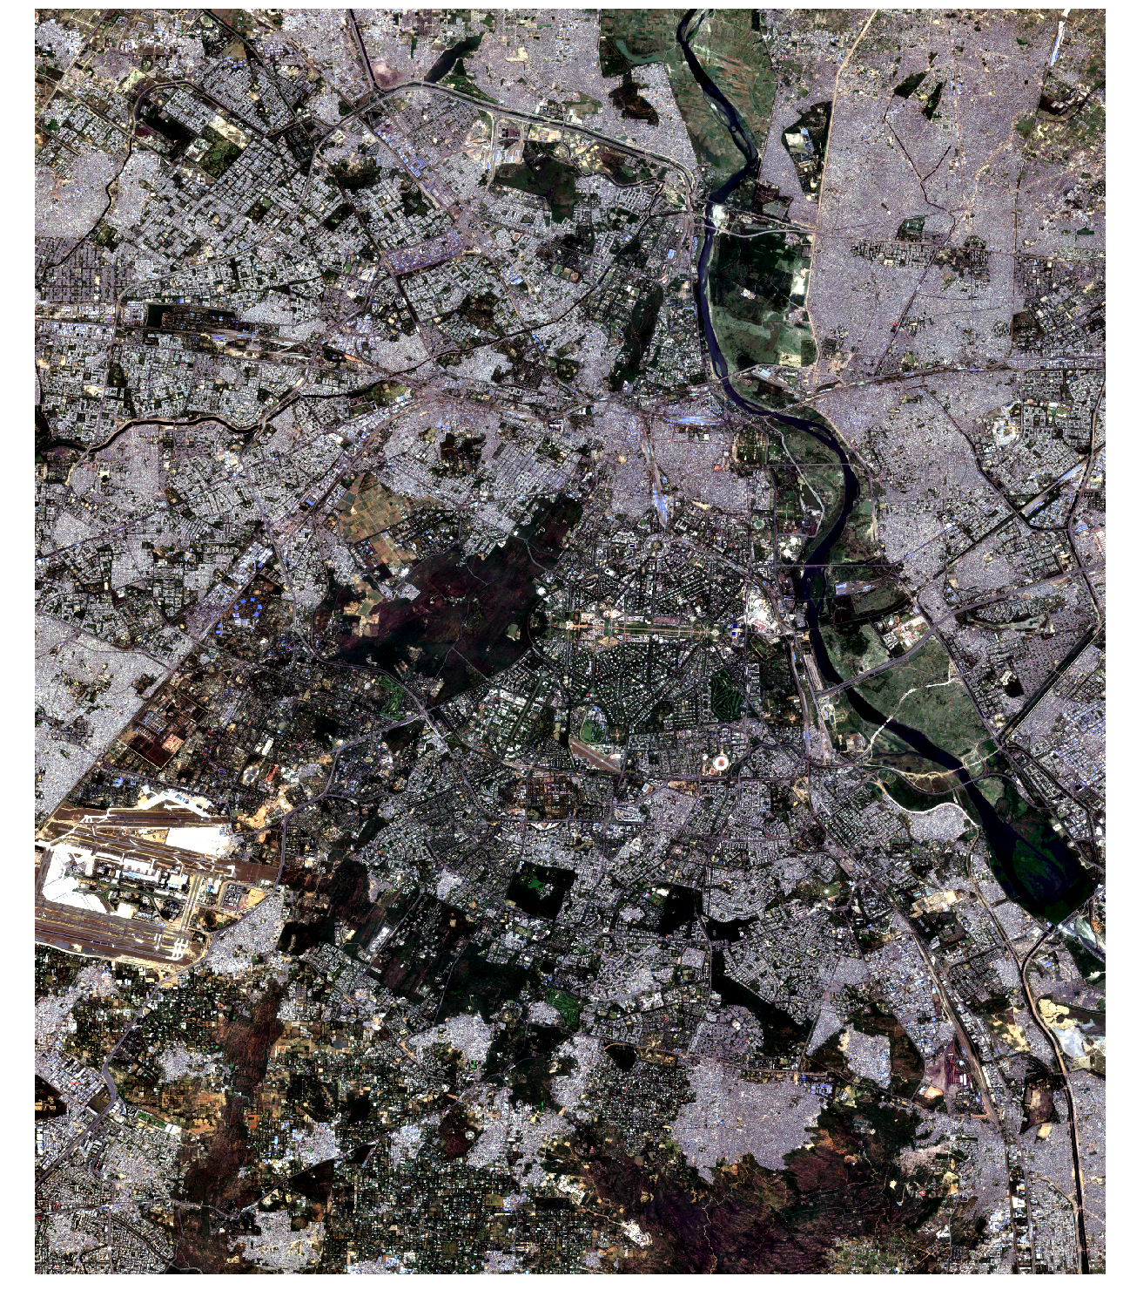
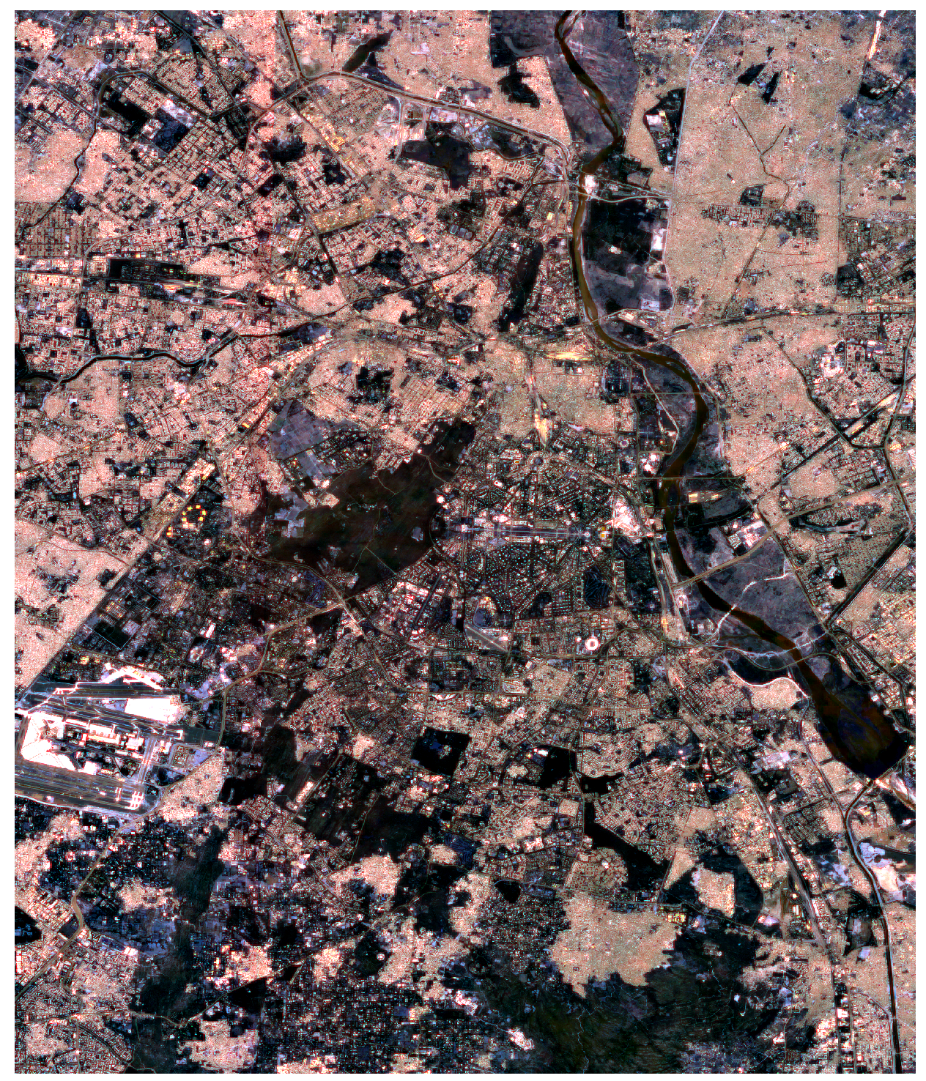
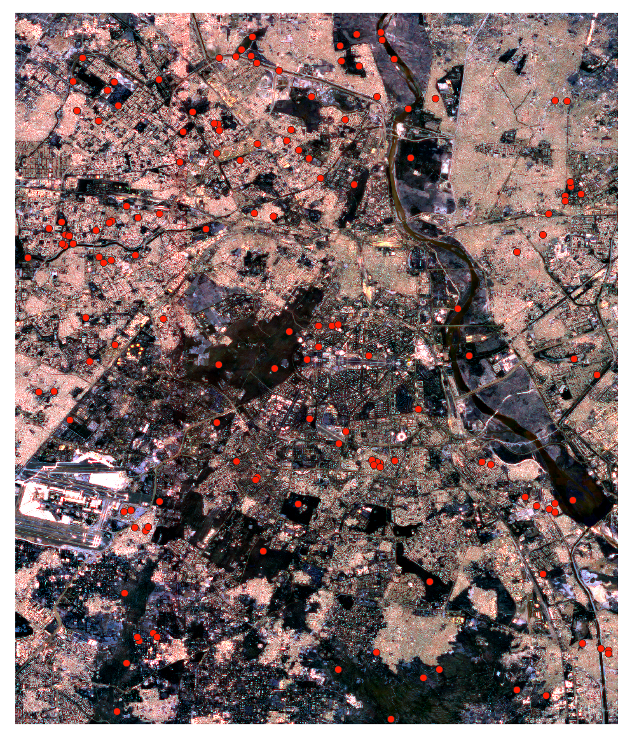
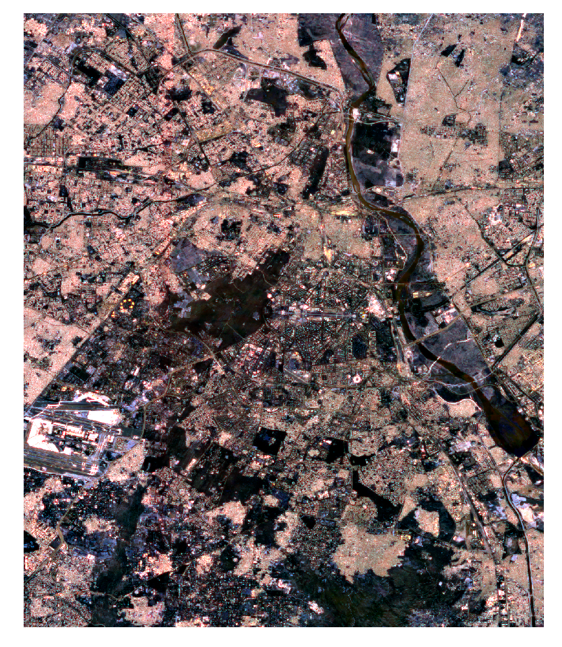
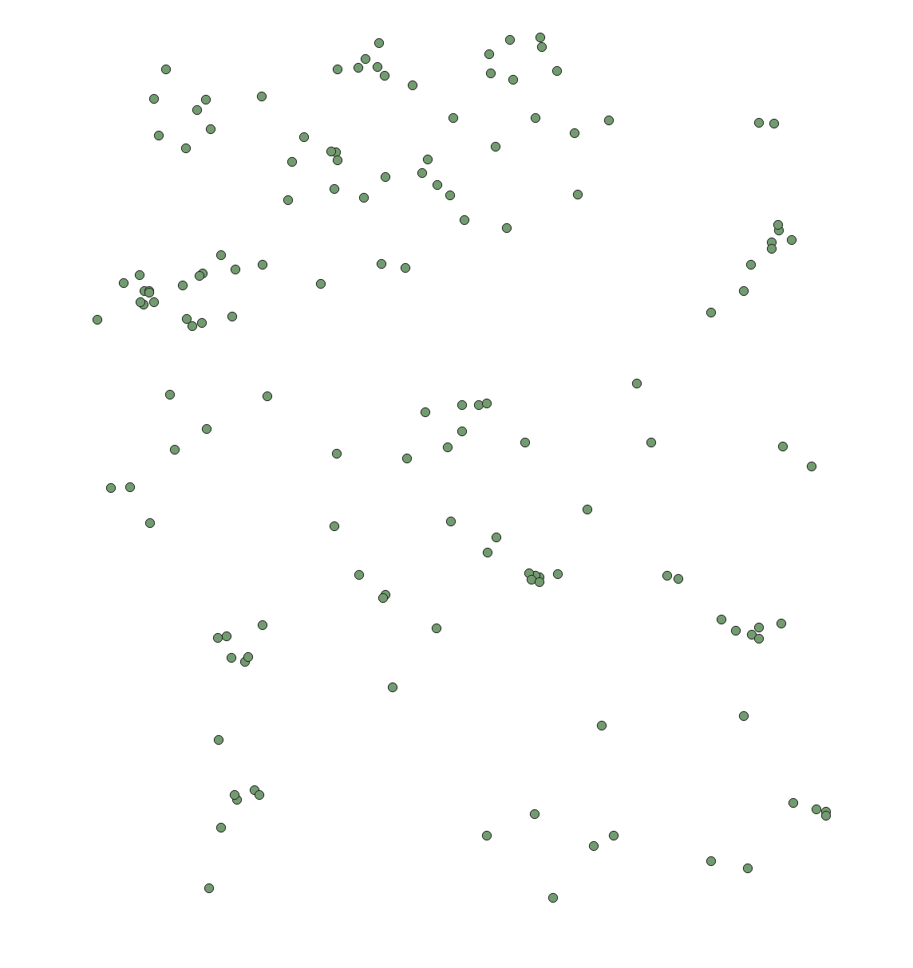
Work Done Till Now
Coloured Image
Training point
Grey Image
Grey + RGB
Image with training points
Resized Image
SHP file

Slide 11
Tools, Technologies and Datasets:
GPU : GPU accelerates LULC classification in ML due to its computational efficiency.
Python : Python is a popular programming language for ML projects.
IDE(Integrated Development Environment): Popular Python IDE such as Google Colab provide an interactive and efficient environment for coding , debugging and experimentation.
Tools : Google Colab, Google Earth Engine,QGIS
1.Google Colab: A cloud-based platform for writing, executing, and sharing Python code, particularly suited for machine learning and data analysis tasks.
2.Google Earth Engine: A platform for planetary-scale environmental data analysis, providing access to a vast archive of satellite imagery and geospatial datasets for scientific research and applications.
3.QGIS: An open-source geographic information system (GIS) software for viewing, editing, and analyzing geospatial data, offering advanced capabilities for spatial analysis and visualization.
Dataset: Harmonized Sentinel-2 MSI: MultiSpectral Instrument, Level-2A [10]

Slide 12
Project Plan:
PHASE I: 31 Jan – 25 Feb)
Data collection and reviewing previous papers.
Data collection and reviewing previous papers.
PHASE II: (25 Feb – 15 March)
Data preprocessing/
Augmentation
PHASE III: (BY 20 April)
Model Development and Decision making
PHASE IV: (By 15 May)
Model Refinement and Final Results

Slide 13
References:
[1]- H. Caesar, J. Uijlings, and V. Ferrari, “Coco-stuff: Thing and stuff classes in context,” in Proceedings of the IEEE Conference on Computer Vision and Pattern Recognition, 2018, pp. 1209–1218.https://ieeexplore.ieee.org/document/9333522
[2]- Ramon Torres, Paul Snoeij, Dirk Geudtner, David Bibby, Malcolm Davidson, Evert Attema, Pierre Potin, BjOrn ̈ Rommen, Nicolas Floury, Mike Brown, Ignacio Navas Traver, Patrick Deghaye, Berthyl Duesmann, Betlem Rosich, Nuno Miranda, Claudio Bruno, Michelangelo L’Abbate, Renato Croci, Andrea Pietropaolo, Markus Huchler, and Friedhelm Rostan, “GMES Sentinel-1 mis-sion,” Remote Sensing of Environment, vol. 120, pp. 9–24, 2012. https://ieeexplore.ieee.org/document/8518327
[3]- Y. Zhou et al., “Remote sensing scene classification based on rotation-invariant feature learning and joint decision making,” EURASIP Journal on Image and Video Processing, no.3, pp. 1–11, 2019. https://ieeexplore.ieee.org/document/9555015
[4]- D. Roy et al., “Landsat-8: Science and product vision for terrestrial global change research,” Remote Sensing of Environment, vol. 2014, pp. 154–172, 03 2014.https://ieeexplore.ieee.org/document/9358947

Slide 14
[5]- J.G.P.W. Clevers and A.A. Gitelson, “Remote estimation of crop and grass chlorophyll and nitrogen content using red-edge bands on sentinel-2 and -3,” International Jour-nal of Applied Earth Observation and Geoinformation,vol. 23, pp. 344 – 351, 2013.https://ieeexplore.ieee.org/document/9323985
[6]- Helber, Patrick, Benjamin Bischke, Andreas Dengel, and Damian Borth."Eurosat: A novel dataset and deep learning benchmark for land use and land cover classification." IEEE Journal of Selected Topics in Applied Earth Observations and Remote Sensing 12, no. 7 (2019): 2217-2226.
https://ieeexplore.ieee.org/document/9726030
[7] -Foody, G.M. Status of land cover classification accuracy assessment. Remote Sens. Environ. 2002, 80, 185–201 https://www.mdpi.com/2072-4292/8/8/684
[8] A. Hamida, A. Benoit, P. Lambert, and C. Amar, “3-D Deep Learning Approach for Remote Sensing Image Classification,” IEEE Trans. Geosci. Remote Sens., vol. 56, no. 8, pp. 4420–4434, 2018. https://ieeexplore.ieee.org/document/9197824
[9] https://www.sciencedirect.com/science/article/abs/pii/S0048969722006519
[10] https://developers.google.com/earth-engine/datasets/catalog/COPERNICUS_S2_SR_HARMONIZED#bands

Slide 15
Thank You

